Slide 1


Slide 2
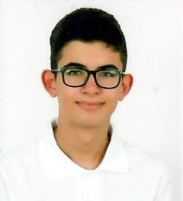
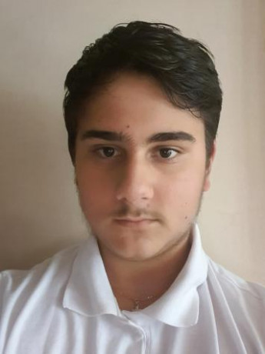
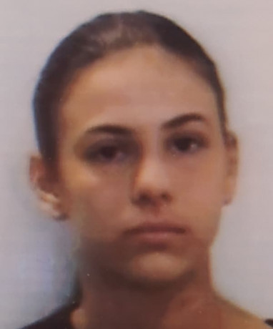
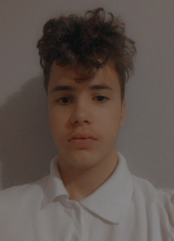
Our team
Konstantin Dinev
Bozhidar Boqdzhiev
Scrum Trainer
Frontend developer
Victoria Bolashikova
Maksim Vasilev
Designer
Backend developer

Slide 3
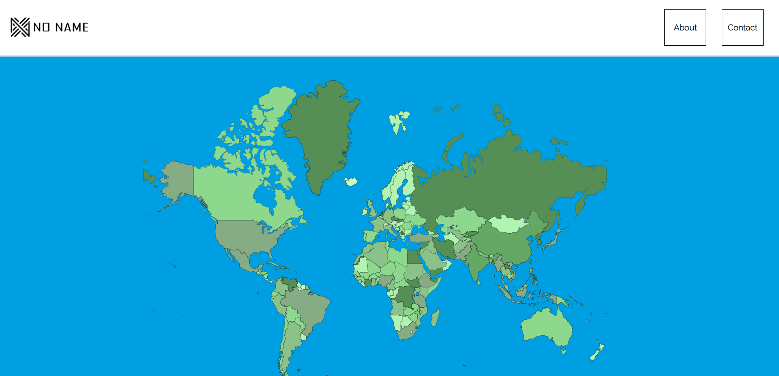
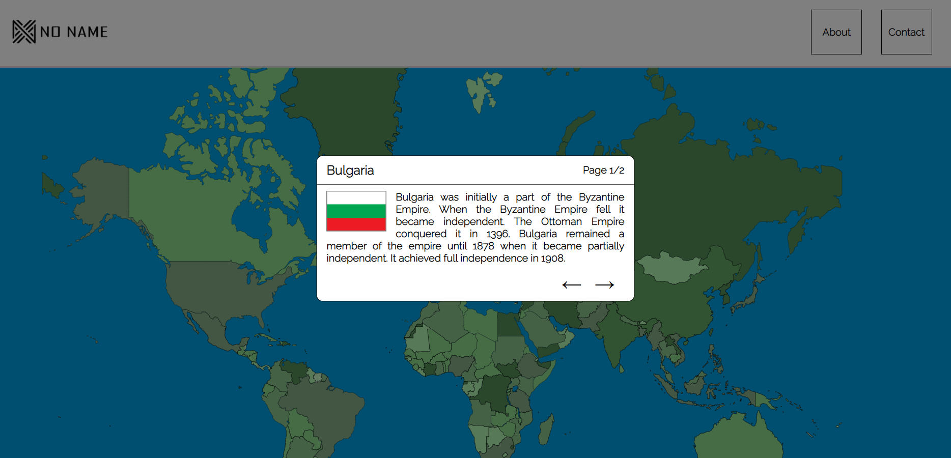
Our idea

Slide 4
Stages of realization
Forming the team
Developing the site
Presenting

Slide 5












Languages and tools

Slide 6
Now let’s visit the website!

